Slide 1
STUDENT NAME: SWETHA A.S
REGISTER NO AND NMID: 24BCA110 3CA9F4954B5F950AA584E444EBF8F9AF
DEPARTMENT: BCA
COLLEGE: Mohamed Sathak College of Arts and Science
1

Slide 2

PROJECT TITLE
DIGITAL PORTFOLIO
1

Slide 3




AGENDA
Problem Statement
Project Overview
End Users
Tools and Technologies
Portfolio design and Layout
Features and Functionality
Results and Screenshots
Conclusion
Github Link
3/21/2024 Annual Review
1

Slide 4

PROBLEM STATEMENT
In today’s competitive digital world, individuals lack a centralized, professional, and visually
appealing platform to showcase their academic
achievements, skills, and projects.
A digital portfolio is necessary to present
personal and professional information effectively.
1

Slide 5

PROJECT OVERVIEW
The Digital Portfolio Website is a personal platform designed to highlight academic, technical, and creative skills.
It contains sections such as About Me, Education,
Projects, Skills, Certifications, and Contact information.
The website is responsive, user-friendly, and
customizable.
1

Slide 6

WHO ARE THE END USERS?
Students – Showcase academic achievements and skills Job Seekers – Highlight projects and certifications Professionals – Build an online personal brand Recruiters/Employers – View candidate portfolios easily
1

Slide 7

TOOLS AND TECHNIQUES
Frontend: HTML, CSS, JavaScript, Bootstrap
Backend: Python (Flask/Django) or PHP (if required)
Database: MySQL / SQLite (optional) Hosting: GitHub Pages / Netlify
Version Control: Git & GitHub
1

Slide 8
POTFOLIO DESIGN AND LAYOUT
The design follows a clean, minimal, and
professional layout with proper navigation. Sections include: Home, About, Skills,
Projects, Education, Certifications, and Contact.
The portfolio is responsive for both desktop and mobile devices.
1

Slide 9
FEATURES AND FUNCTIONALITY
User-friendly interface with smooth navigation
Responsive design for mobile and desktop Sections for About, Projects, Skills, and Contact Integration with LinkedIn/GitHub Downloadable Resume option

Slide 10

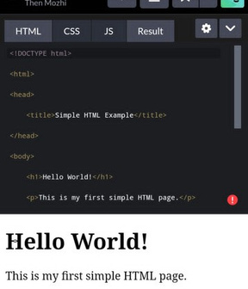
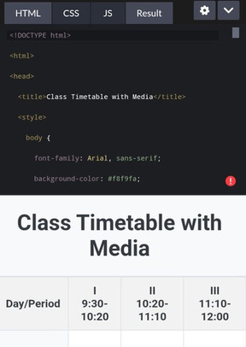

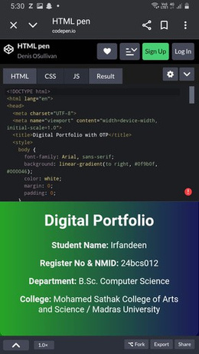
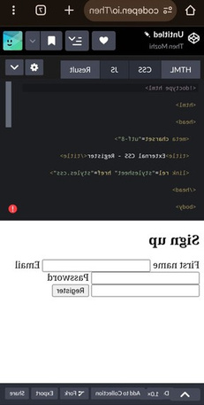
RESULTS AND SCREENSHOTS
3/21/2024 Annual Review
10

Slide 11
CONCLUSION
The Digital Portfolio Website provides an organized and professional way to present personal achievements, skills, and
projects.
It enhances career opportunities and creates a strong digital presence
10

